Slide 1
Utilizing Meteorological Data with Supervised Learning to Predict Snowfall Amounts at Copper Mountain Ski Resort
Dustin Rapp

Slide 2
Introduction
Prognostic models have difficulty predicting snowfall for specific mountains and slopes
More accurate site specific snowfall forecasts could potentially improve ski resort operations
Copper Mountain unique as multiple official meteorological stations are near or onsite, each with freely available data
Could Supervied Learning be used to site specific snowfall?

Slide 3
Overview
Outline
Data Utilized
Modeling Methodology
Feature Selection
Model Performance
Model Diagnostics
Recommendations
GOAL:
Given knowledge that a snowfall event is going to occur, goal of this assessment is to:
1.) Determine how well an Ordinary Least Squares model might perform at predicting how much snowfall will fall over 12 hours given meteorological observations at the start of those 12 hours
2.) Make recommendations regarding improving model performance

Slide 4
Surface Data
Station ID | Station Type | Location | Elevation | Meteorological Measurements Utilized | Temporal Resolution
SNOTEL 415 | NRCS SNOTEL | Popular Ski Runs midway up Copper Mtn | 10550’ | Temperature Snow Depth | Hourly
KLXV | NWS ASOS | ~25 mi SW of Copper Mtn | 9938’ | Temperature Dewpoint Wind Speed Wind Direction Pressure 12-hr Pressure Changes* | Hourly
KCCU | CDOT AWOS | Near top of Copper Mtn | 12075’ | Temperature Dewpoint Wind Speed Wind Direction | Hourly
*Calculated feature

Slide 5
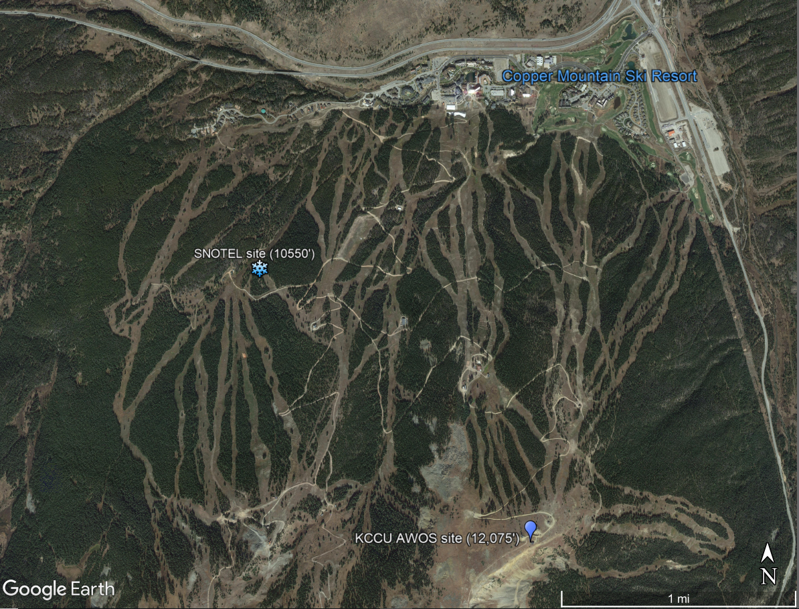
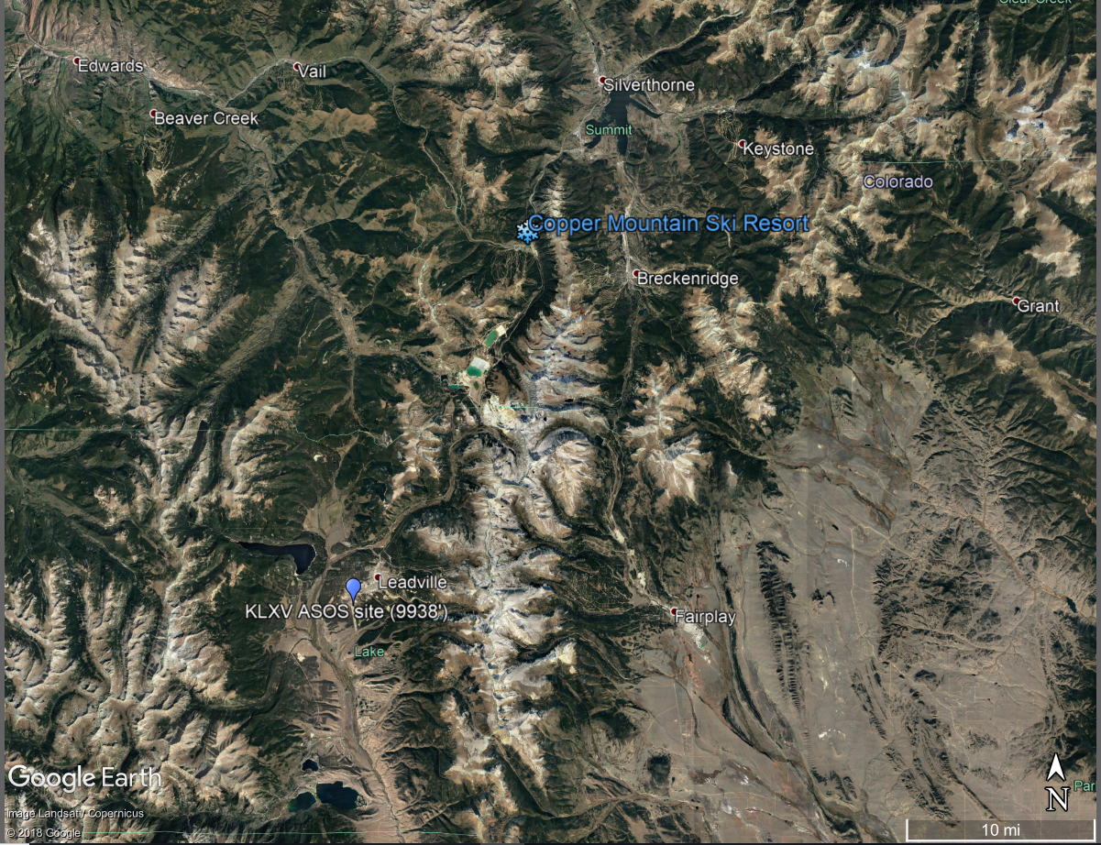
Surface Data Monitor Locations

Slide 6
Additional Upper Air Data
Snowfall is highly dependent on physics of crystal development, which is affected by upper air physics. Therefore, upper air data was also included
Station ID | Location | Pressure Levels | Measurements at each Level | Temporal Location
KJCT | Grand Junction, CO | 200mb, 250mb, 300mb, 400mb, 500mb, 700mb, & 850mb | Height Temperature Dewpoint Wind Speed Wind Direction | 12 hour
Differences in meteorological measurements between Pressure Levels are common considerations when forecasting snowaffall so were also calculated and included (e.g. 500mb Dewpoint minus 400mb Dewpoint) as additional features

Slide 7
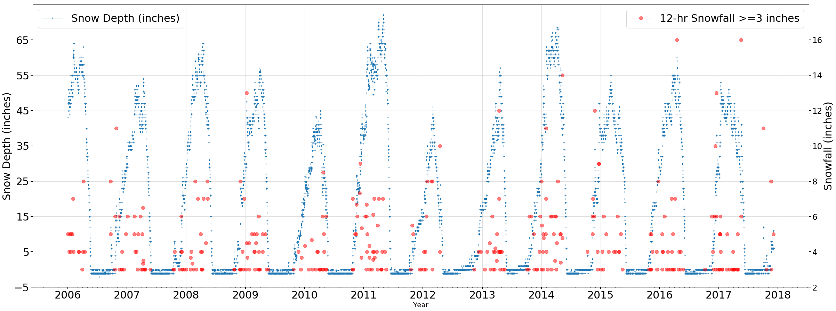
Snowfall vs Snow Depth
SNOTEL stations report snow depth. Snowfall was calculated.
12-hr snowfall only. Events >=3” due to noise in data.

Slide 8
Modeling Methodology
Ordinary Least Squares (OLS) model
Linear Regression Analysis performed for all features
Datasets divided into two Training/Test partitions
Features for use in model chosen using forward stepwise approach
Two model runs were fit on each of the two training partitions:
Surface Data Feature Only
Surface Data plus Upper Air Data Features
Fitted models were then tested on respective test datasets to assess snowfall prediction

Slide 9
Test/Training Partitions
Partition A:
Test set: Years 2006 and 2017
Train Set: Remaining Years 2007-2016
Partition B
Test Set: Year 2014
Train Set: Remaining years - 2006-2013, 2015-2017
Each of the these divisions resulted in ~80% Training/~20% Test Datasets

Slide 10
Feature Selection
Statsmodel using forward stepwise approach on Training Datasets
Adjusted R² used as metric
Optimized such that individual feature t-statistic confidence intervals (p values) were minimized
Upper Air Data did improve Adjusted R²
Partition A – Best Combination of Features
Dataset | Adj. R-squared: | F-statistic: | Prob (F-statistic):
Surface Data Only | 0.044 | 3.765 | 0.0118
Surface+Upper Air Data | 0.129 | 3.087 | 0.000606
Partition B – Best Combination of Features
Dataset | Adj. R-squared: | F-statistic: | Prob (F-statistic):
Surface Data Only | 0.063 | 4.166 | 0.00297
Surface+Upper Air Data | 0.142 | 3.236 | 0.000229

Slide 11

Model Performance of Snowfall Predictions
Model | Sci-kit R2 Score | RMSE (inches)
Partition A (Surface Data Features only) | 0.046 | 2.6
Partition A (Surface+Upper Air Data Features) | 0.128 | 2.487
Partition B (Surface Data Features only) | -0.174 | 2.785
Partition B Surface+Upper Air Data Features) | -0.412 | 3.055
Partition A model performed better then Partition B model
The Partition B models performed very poorly by all metrics
Upper Air Data did improve performance in the Partition A cases.
Why such bad performance for Partition B??
Much room for improvement! But many opportunities..

Slide 12
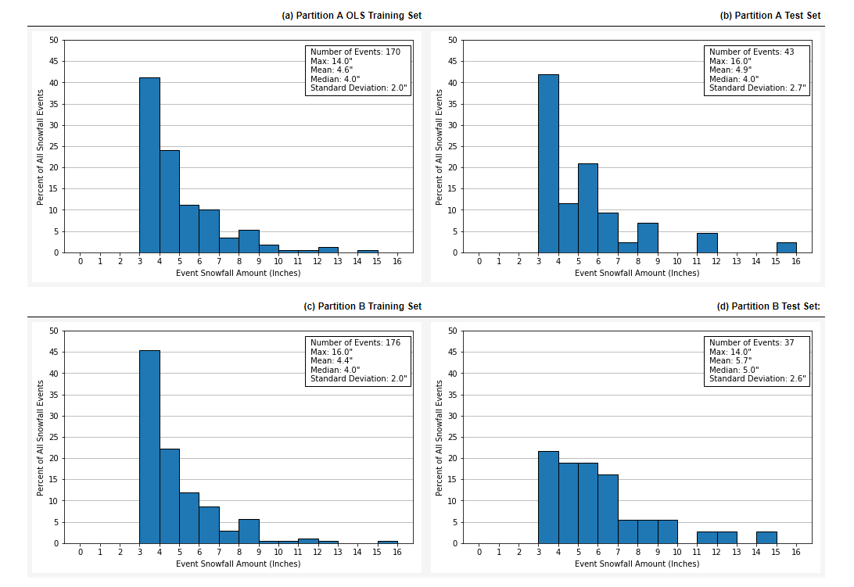
Snowfall Distributions between Training and Test Set
Partition B Test and Training set snowfall distributions very different, likely causing poor performance
Both Partition A Test/Train sets are heavily weighted by lighter snowfall – may tend to underpredict higher snowfall events.

Slide 13
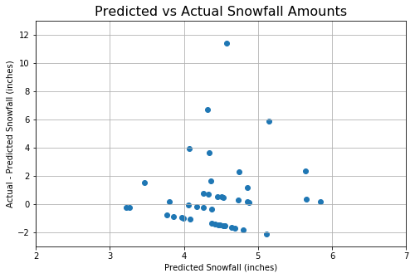
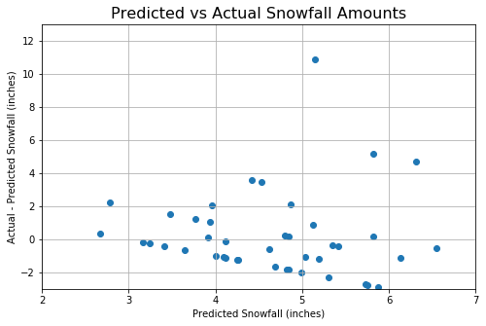
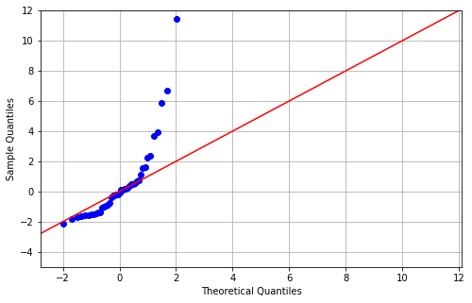
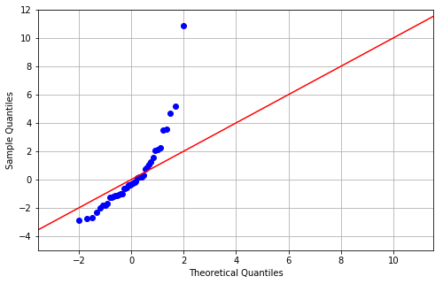
Upper Air Data Inclusion (Partition A)
Large number of smaller snowfall events in training set caused lower underpredictions in higher snowfalls
Despite large number of small snowfall events, upper air data did improve predictions of these events

Slide 14
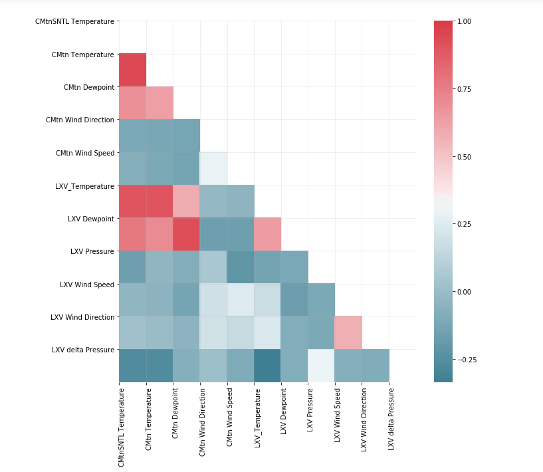
Multicollinearity and Non-linear features
Multicollinearity
Due to proximity, temperature trends between sites were similar
In upper air data, heights were strongly correlated.
Non-linear features
Though there was found to be predictive capability, Wind Direction is by nature not a linear variable and may not be beneficial in all cases, especially when winds are more northerly.
Likely negatively influencing model

Slide 15
Non-linearity considerations
Sometimes 1” of melted can equate up to a foot of snow. Finer snow could result in two feet or more
Snowfall must consider temperatures where the snow develops (upper air), as well as amount of moisture available.
Breaking model down into finer components (e.g. try to predict amount of moisture to fall vs snowfall) may be better approach

Slide 16
Recommendations
The initial model results did indicate poor performance. However, there are several opportunities to optimize predictive capabilities. These include:
While the Partition B model runs did indicate that Upper Air data would not improve performance, the Partition B Test and Training snowfall distributions were much different. Partition A modeling is likely a better gauge of performance, and upper air data did show potential to better predict the more extreme events in that model Therefore, upper air data should be utilized with surface data in future assessments.
Investigate collinear features more, and consider eliminating some of the strongly collinear features which may be negatively influencing the model's ability to predict.
If some collinear features are retained, the Ridge Regression may be a more appropriate method
Work to balance the distribution of large and smaller size snowfall events in the training to improve prediction of larger snowfall events. As shown, the training data set was heavily influenced by smaller, more inconsequential snowfall events. This led to the model to bias its prediction to only small snowfalls to reduce sum of squared errors.
Investigate whether wind direction (a rotational feature by nature) should be transformed in someway to allow it to work better with a linear model
Other supervised model types should be considered as non-linear relationships may be occurring.
As snowfall events are dependent on both crystal nature of snow as well as amount of precipitation, consider using model to just predict amount of moisture that is expected to fall at first - then add additional complexity of snow depth. Snow water equivalent is another measurement which is measured at the SNOTEL site.
The snowdepth dataset contains both information in increases in snowdepth and well as decreases in snowdepth. This model may be extended to identify days of rapid snowmelt.

Slide 17
Acknowledgements
Thanks to Dr. Guy Maskall of Springboard for mentorship during the preparation of this analysis

